Slide 1
Hearing Loss in Alport Syndrome
Dr Sudhira Ratnayake
Consultant in Audiovestibular Medicine
Gem Centre
Royal Wolverhampton NHS Trust

Slide 2
Presentation outline
How does the ear work?
Why is the hearing organ involved in AS?
How does hearing loss appear in AS?
How is hearing loss managed?

Slide 3
What are the parts of the ear?

Slide 4
How does the ear detect sounds?

Slide 5
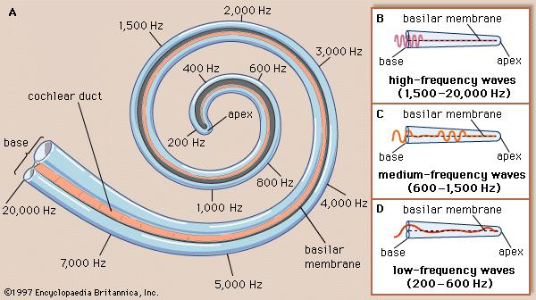
Cochlea – the hearing sensory organ

Slide 6
Why is the cochlea involved in AS?
Type IV Collagen in kidneys, eyes and cochlea
Notes:
Normal retrocohlear (ABR) pathways, i.e. the effect is in the cochlea

Slide 7
The sound sensory organ

Slide 8
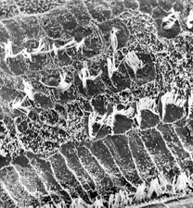
Normal and damaged “hair cells”

Slide 9
125
250
500
1000
2000
4000
8000
LOW PITCH
HIGH PITCH
From: NDCS
FREQUENCY IN CYCLES PER SECOND (HZ)

Slide 10
SOFT
0
10
20
30
40
HEARING LEVEL (dB HL)
50
60
70
80
90
100
LOUD
110
120
From: NDCS

Slide 11
What is an audiogram?
Degree or Level of hearing loss
Normal: Less than 20 dB
Mild: 21 – 40 dB
Moderate: 41 – 70 dB
Severe: 71 – 95 dB
Profound : Worse than 95 dB
From Oticon

Slide 12
Causes of hearing loss
½
Prevalence of AS – 1% of all children with childhood deafness (Flinter, 1990)

Slide 13
Hearing loss in AS
Hearing loss (HL) is one of the first features
55% of males and 45% of females with AS
X-linked boys: common towards end of first decade of life or early teens
X-liked girls: HL less frequent and later in life
Autosomal Recessive AS (both sexes): childhood HL
Autosomal Dominant AS: Later ages

Slide 14
Hearing loss in AS
Typically sensorineural i.e. affecting the cochlea
Variable degrees or levels of hearing loss
Typically affecting the middle and high frequencies, bilateral and symmetrical
Progression of hearing loss suggests poor prognosis of renal disease

Slide 15
Progression of hearing loss in AS: 1st and 2nd decades of life
Audiogram pattern | Mean age in years | Prevalence (%)
Flat | 8.5 | 11.7
“Cookie-bite” (Ascending) | 13.7 | 47.1
Descending | 17.8 | 41.2

Slide 16
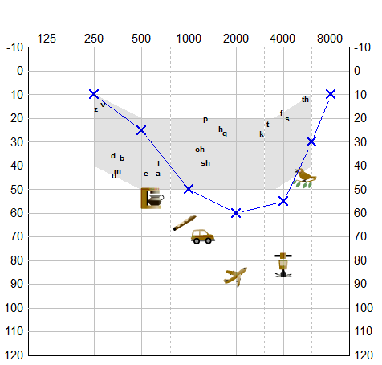
Deafness: first feature to be detected!
Boy, born in Nov 2001
Referred from school hearing screening – no hearing or speech concerns before this
Two sisters – normal hearing
Urine: ++++ microscopic haematurea → Genetically confirmed Alport Syndrome
Bilateral mid to high frequency moderate Sensorineural Hearing Loss

Slide 17
Progressive hearing loss
Nov 2009
Sept 2014
Boy, born in Dec 2005
Passed Newborn Hearing Screening, normal birth
Referred by Nursery Nurse at age 3 years – speech delay
Persistent microscopic haematuria → Genetic variant of Alport Syndrome
Mother – same genetic variant, no haematuria but has bilateral high freq. hearing loss

Slide 18
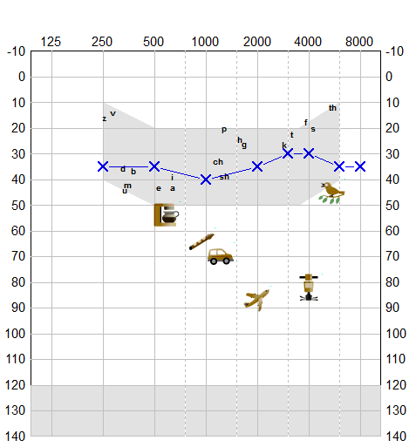
Late identification of hearing loss
22yr old male referred via GP due to hearing difficulties
Potential Kidney donor to his mother → microscopic Haematuria → investigations → abnormal kidney biopsy
Mother in 50’s → End stage renal failure → Bilateral hearing aid user
Bilateral mild sensorineural hearing loss

Slide 19
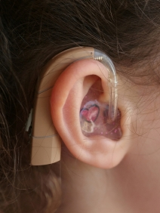
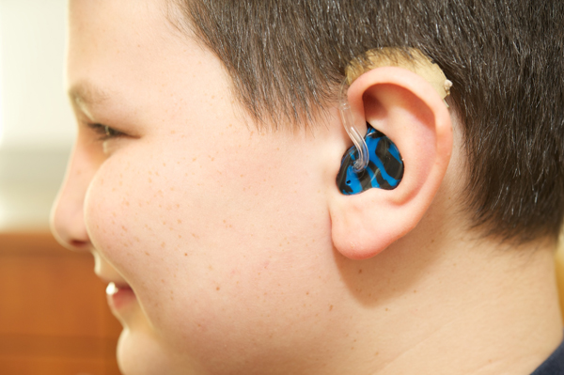
Managing hearing loss
Ensure effective communication
School, work place, home
Non-verbal cues, Signing
Hearing Aids
Assistive devices
Hearing Protection
Drugs causing damage to hearing
Noise

Slide 20
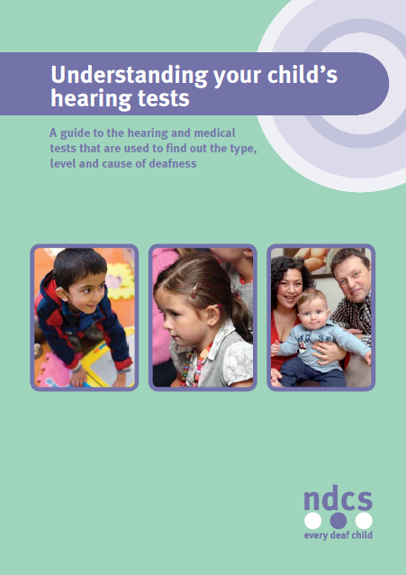
Helpful organisations
Support Groups
National Deaf Children’s Society
www.ndcs.org.uk
Action on Hearing Loss
www.actiononhearingloss.org.uk
Alport UK
Professional organisations
British Association of Audiovestibular Physicians www.baap.org.uk
Guidelines on investigating the cause of hearing loss

Slide 21
Summary
Investigate the underlying cause of hearing loss
Other organs in the body may be involved
Overall diagnosis
Regular monitoring of hearing levels in AS
Look for progression
Worsening hearing loss may indicate deterioration in kidney function

